Slide 1





MODY UNIVERSITY OF SCIENCE AND TECHNOLOGY
SUMMER INTERNSHIP PROJECT
A FACIAL EMOTION RECOGNITION SYSTEM USING MACHINE LEARNING
RITIKA RATHI
200381
III YEAR

Slide 2

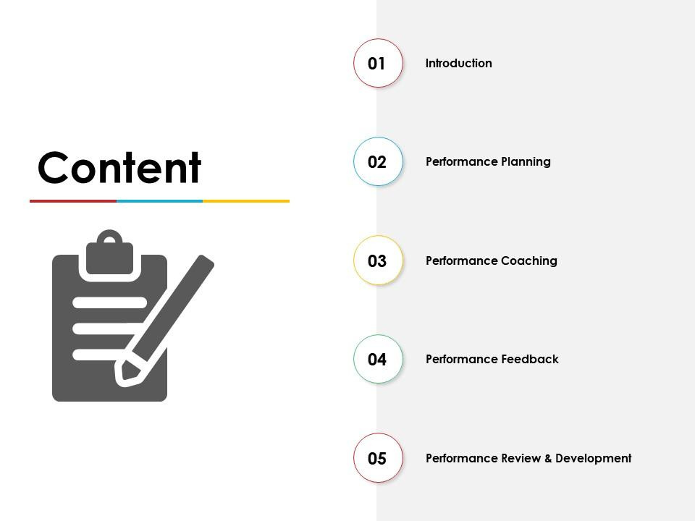
CONTENT
Introduction
Proposed System
System Architecture
Technology Used
Applications
Snapshots

Slide 3
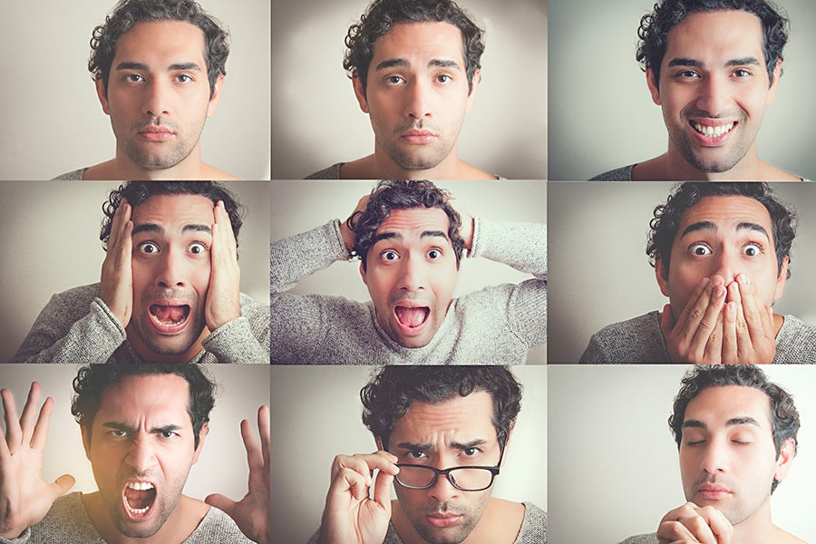
INTRODUCTION
Facial emotion recognition is the process of identifying human emotions but with the help of technology. In this the faces are matched to available dataset to find out the human emotion. They are mostly used in biometric, government cyber security areas. They use camera of the device to capture the image and then detect its emotion.

Slide 4
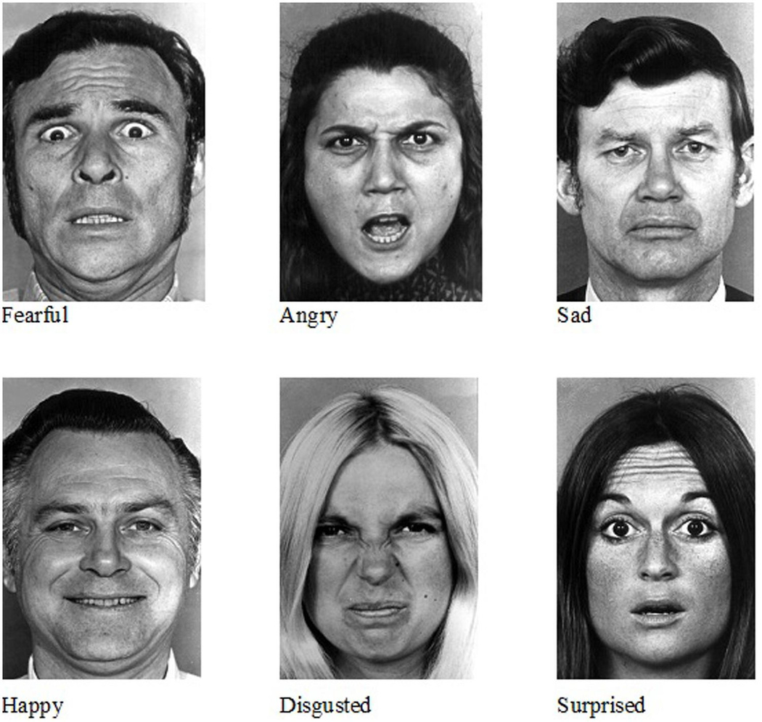
PROPOSED SYSTEM
This proposed system capable of performing automatic facial expression or emotion recognition of seven universal emotions considered as happy, sad, anger, surprise, neutral, disguise, fear. Such system would analyze image of the face and produce calculated prediction of the expression. The approach integrates a module for automatic face detection, by generating neural network using training dataset.

Slide 5
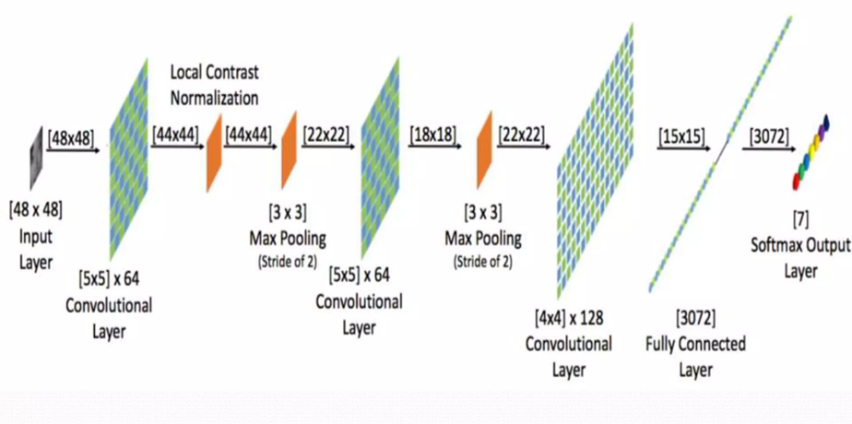
System Architecture

Slide 6
TECHNOLOGY USED
Keras
It is a open source software library that provides Python interface for artificial neural networks.
Pandas
It is a software library written for python programming language for data manipulation and analysis.
Matplotlib
It is a plotting library for Python programming language and its numerical mathematics extension NumPY .

Slide 7
OPEN CV
Open CV is a open source library for computer vision. It provides facility to the machine to recognize faces and objects.
NumPY
NumPY is a library for Python programming language , adding support for large, multi-dimensional arrays and matrices along with large collection of high-level mathematical functions to operate on this array.

Slide 8
Applications
Following are the rapidly growing areas where system can be used-:
Camera or in cell phone camera applications.
For advertising.
Content creators to sell products.
Learner emotion detection.
Film industries and q-sensor to guise emotion of the children.

Slide 9

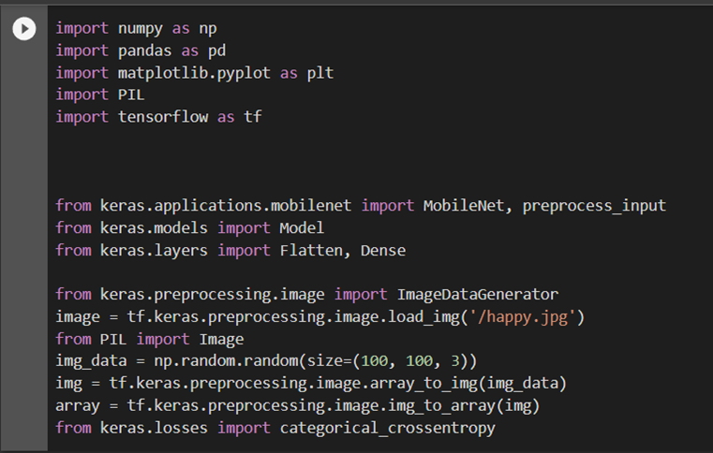
Snapshots

Slide 10
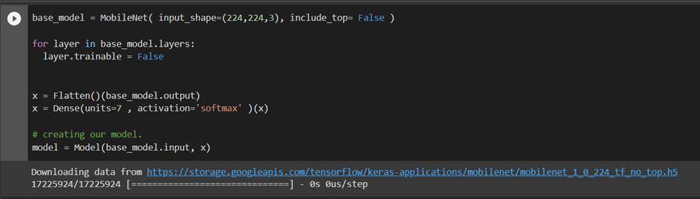
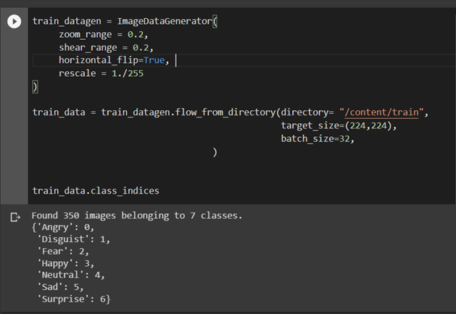

Slide 11
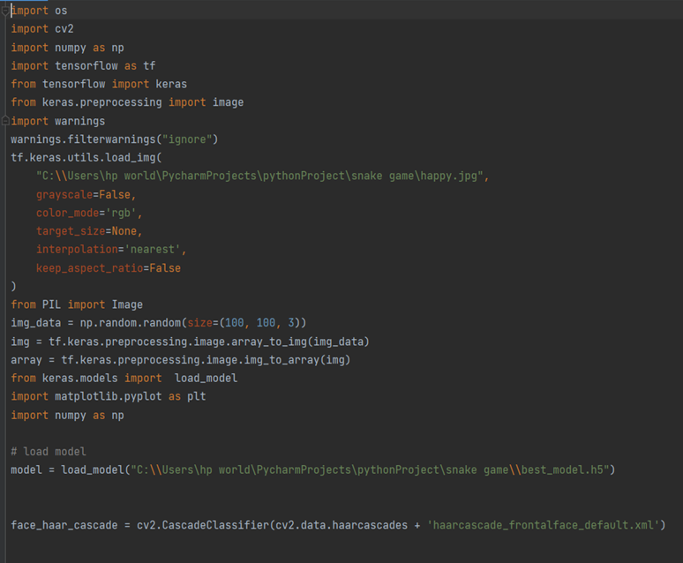

Slide 12
Thank You!

